Slide 1
TOPIC A1:
COMPUTER FUNDAMENTALS
LESSON A1-3
SECONDARY STORAGE, COMPRESSION, & SAAS

Slide 2
AGENDA
Secondary storage: what is inside the machine
Secondary storage: what you can unplug
Lossy and lossless compression
Run-length encoding
Transform coding
Cloud services: SaaS, PaaS, IaaS
PA A1-2: Compression
WHAT U NEED 4 LESSON
PyCharm
Guided Notes

Slide 3
THE WARM UP QUESTION
Everything we looked at last lesson was primary memory. There was no storage that is non-volatile and writeable.
(a) State what is meant by volatile memory.
(b) From registers, cache, RAM and ROM, identify the one that is non-volatile.
(c) Your PA A1-1 cache hit 40% of the time. A hit costs 1 ns, a miss costs 100 ns. Calculate the average access time.
-> Notes Q1 (a)-(c) [3 marks] - do them now

Slide 4
THE WARM UP ANSWER
(a) Memory that loses its contents the moment power is removed
(b) ROM - it holds the firmware (BIOS/UEFI) whether the machine is plugged in or not
(c) 0.4 x 1 + 0.6 x 100 = 60.4 ns

Slide 5
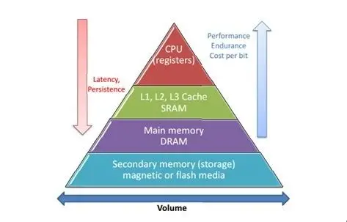
SECONDARY STORAGE
Primary memory includes Registers, Cache, RAM, and ROM
Fast, small, and non-volatile (other than ROM)
Secondary storage is where data sits when the power is off: non-volatile, far bigger, far slower
The CPU cannot execute anything directly from it, everything is copied into RAM first.

Slide 6
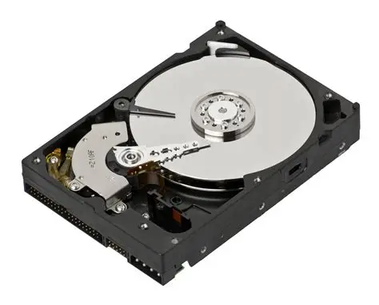
INTERNAL SECONDARY STORAGE
HDD - Hard Disk Drive
Data stored magnetically on spinning metal platters; a read/write head swings across on an arm
Think like a record player, but data is magnetic, not etched
Moving parts, so it is slower, noisier, and does NOT like being dropped
Max out around 160 MB/s
Cheapest per gigabyte, can be large capacity
Found in: desktops, servers, bulk archives

Slide 7
INTERNAL SECONDARY STORAGE
Fun fact!
The rumor that using a magnet near a computer will break it is because of hard drives
Because these store data using magnetic media, a magnet will break a hard drive, making it seem like the device is broken

Slide 8
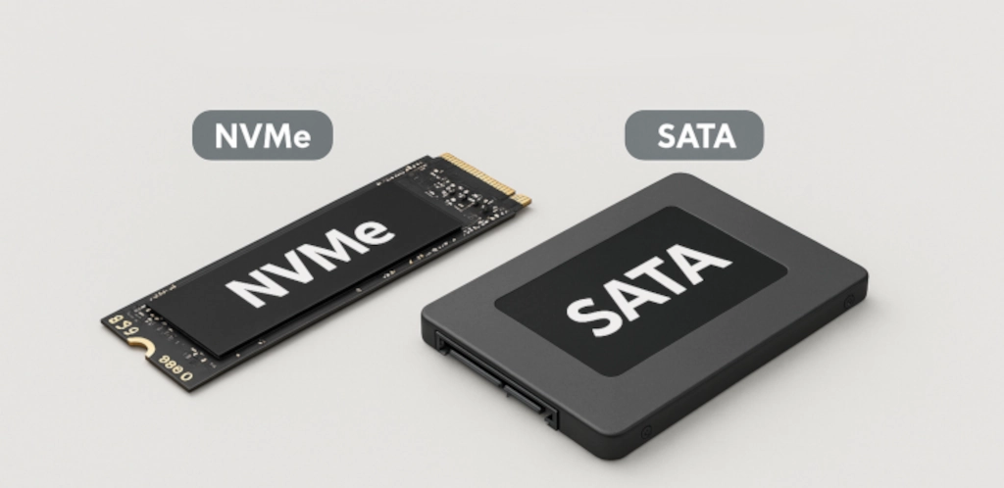
INTERNAL SECONDARY STORAGE
SSD - Solid State Drive
Data stored as trapped electrical charge in flash memory cells. No moving parts anywhere
Roughly 550 MB/s over SATA (type of connection cord), up to about 3500 MB/s over NVMe (screwed straight into motherboard)
More expensive per gigabyte
The cells wear out after a very large number of writes
Found in: pretty much everything nowadays. Laptops, even most desktops now
They’re just so much faster than HDDs lol

Slide 9
INTERNAL SECONDARY STORAGE
eMMC - embedded MultiMediaCard
Flash memory and its controller soldered straight onto the motherboard
Like a USB drive or SD card
Cheap and compact, slower than a real SSD, and not upgradeable - it is part of the motherboard
Found in: phones, tablets, Chromebooks, cheapo laptops, smart TVs
If a laptop advertises 64 GB of storage and never says SSD, this is what it has. Y’know your cheap $150 Walmart laptop fare.

Slide 10
HOW LONG DOES ONE READ TAKE?
Run: A1-StorageSpeeds.py
-> Notes Q2 [6 marks] - fill in the internal storage table now

Slide 11
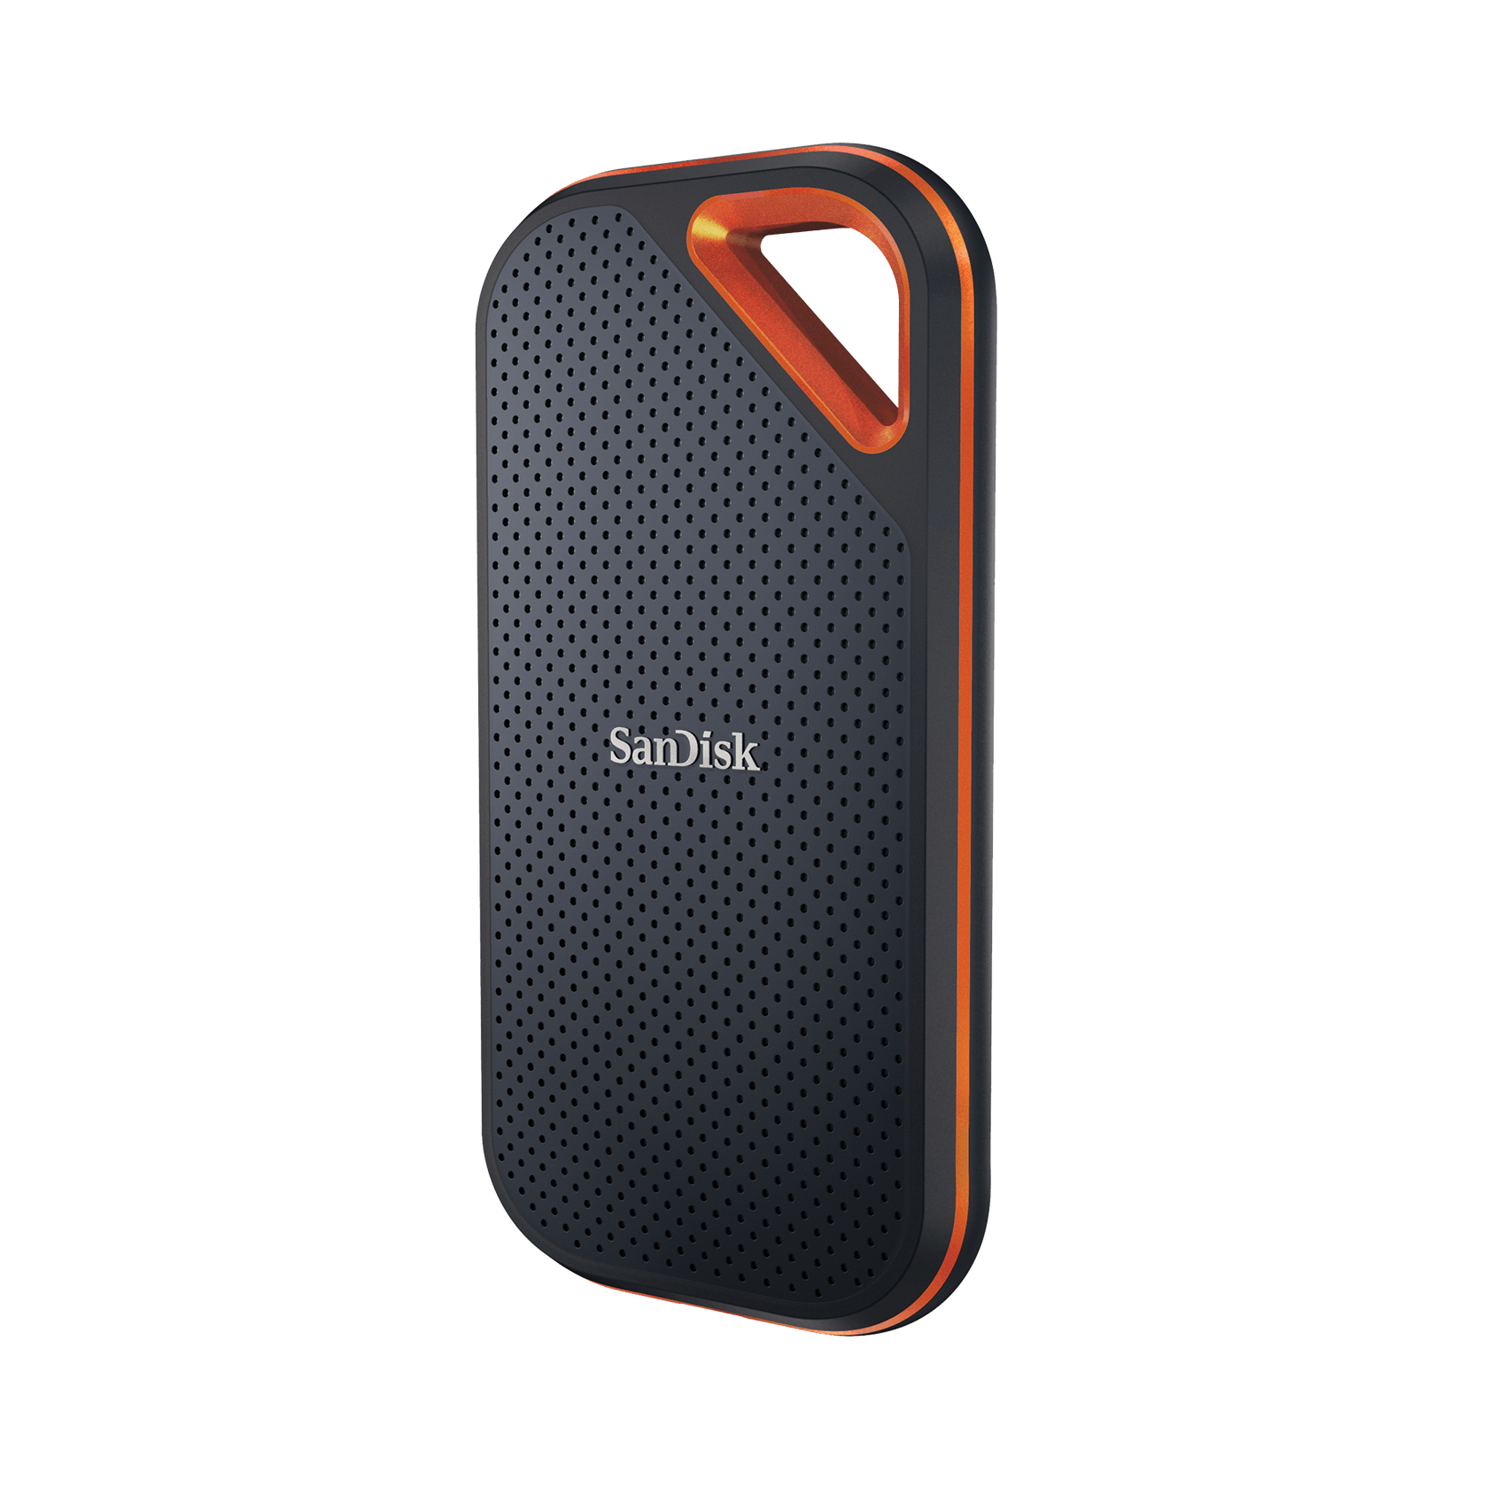
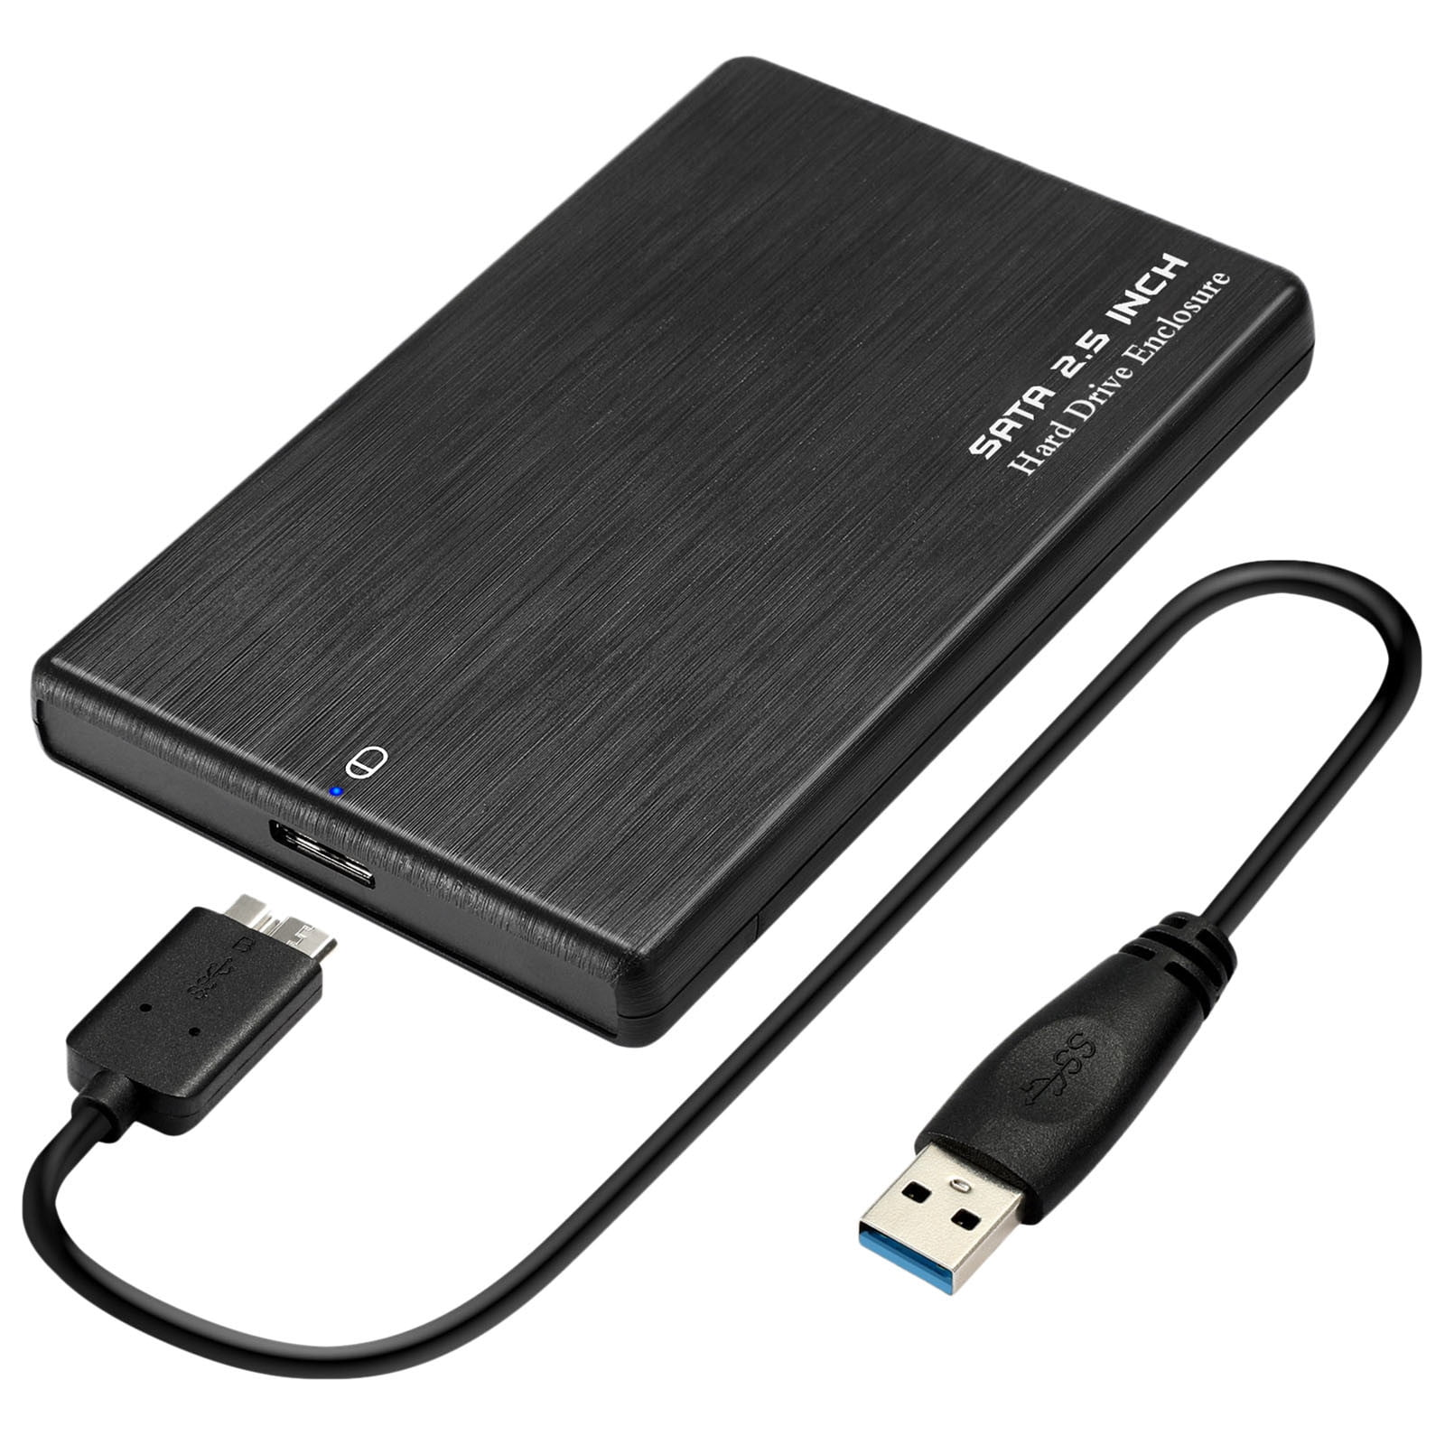
EXTERNAL SECONDARY STORAGE
We can use the same technology we used inside on the outside
External HDD - cheap bulk capacity. Backups, archives, moving big files. Still fragile.
I keep my portable piracy drive on one of these bad boys
External SSD - fast, pocket-sized, no moving parts, more expensive per gigabyte
Both arrive over USB, which becomes the speed bottleneck

Slide 12
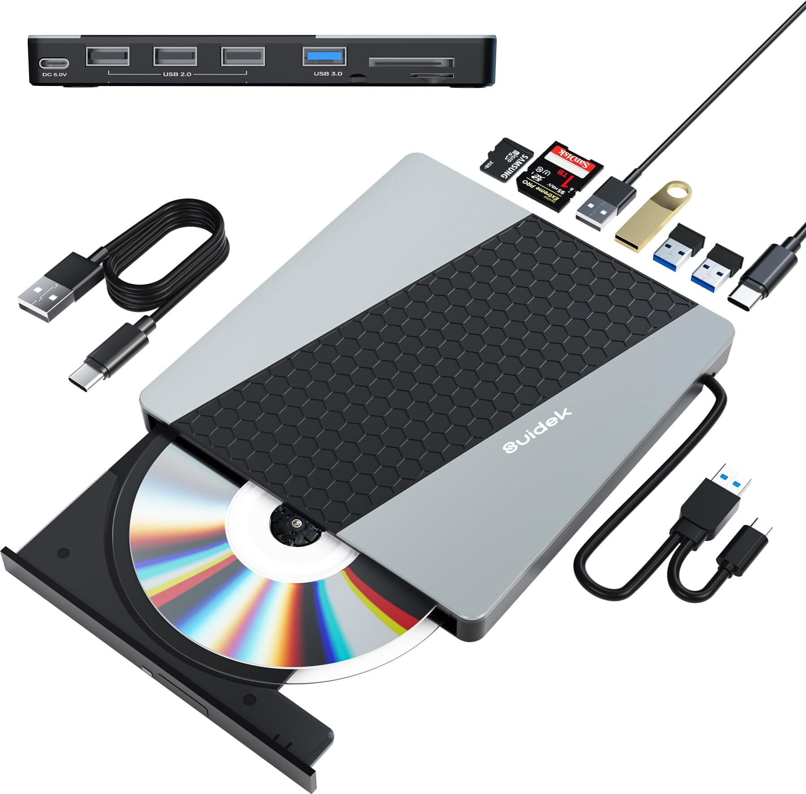
OPTICAL, FLASH, AND CARDS
Optical drive - CD, DVD, Blu-ray. A laser reads pits in a reflective layer. Slow, cheap, and a written disc cannot be easily edited
Flash drive – aka USB stick. Small capacity, durable, easy to lose
Memory card - SD and microSD. Cameras, drones, Nintendo Switch, single-board computers (like the raspberry pi)
Archivists still buy optical discs
Blu ray discs are projected to be able to survive for longer than anybody has ever lived, so

Slide 13
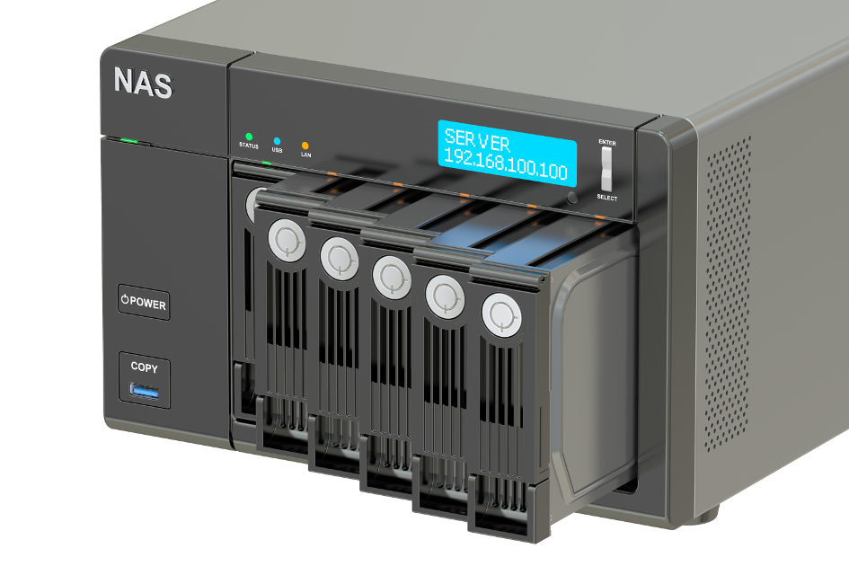
NETWORK ATTACHED STORAGE
NAS - Network Attached Storage my beloved
One or more drives in a box with its own network connection, sitting on the LAN (local area network)
Every device on the local network reads and writes to it at once
Works over Ethernet or Wi-Fi
Usually several drives holding duplicate copies, so one failure does not lose the data
RAID configuration (Redundant array of independent disks)
I use one of these as my personal backup at home, it’s super convenient

Slide 14
PICK THE RIGHT DRIVE
-> Notes Q3 (a)-(b) [4 marks] - do them now
(a) 4 TB of raw footage posted to an editor in another city, small budget
(b) Four laptops in one house, automatic backups, over Wi-Fi

Slide 15
COMPRESSION
Even if storage is cheap, bandwidth and patience might not be
Compression re-encodes a file so it needs fewer bits
There are two types of compression
We decide which type of compression we need based on how important it is that we need every single original bit back

Slide 16
LOSSLESS COMPRESSION
Lossless compression - the original file can be reconstructed with all bits
Works by removing redundancy: repetition, patterns, sequences that appear often
Common formats: ZIP, PNG, FLAC, GIF
Use these where any modification to the information is vitally important - code, spreadsheets, databases, text
Lossless compression doesn’t typically save that much space

Slide 17




LOSSY COMPRESSION
Lossy compression - some of the data is lost permanently
Works by discarding detail that human eyes and ears are (hopefully) bad at noticing
Formats: JPEG, MP3, AAC, MP4
Space saved is much bigger
Here we see John Compression at 100%, 30%, 5%, and 1% quality
The important part to note here is how close 30% is to 100% quality

Slide 18
LOSSY, LOSSLESS, AND YOUR NOTES
-> Notes Q4 (a)-(b) [4 marks] - do them now
Q4 (a) Distinguish between lossy and lossless compression. [2]
Q4 (b) State one file format that uses lossy compression and one that uses lossless. [2]
'Distinguish’ means both sides in one comparison, not two definitions back-to-back

Slide 19
RUN-LENGTH ENCODING
Run-length encoding (RLE) - a lossless method. Every run of identical values becomes the count followed by the values
WWWWWWWWWWWWBBBBBBWWWWWWWWWWWW becomes 12W6B12W
30 characters down to 8, and we can reverse these steps to get back to the original
The compression ratio is the original size divided by the compressed size. Here, 3.75 : 1.

Slide 20
YOUR TURN, BEFORE THE CODE RUNS
Encode this one on your notes, then check it with the class: (Question 5 a and b)
WWWBBBWWWBBBWWWBBB
Now this one:
ABABABABABABABABAB
Which of these will compress more smoothly?

Slide 21
RUN LENGTH DATA
WWWWWWWWWWWWBBBBBBWWWWWWWWWWWW -> 12W6B12W
73.3% saved
WWWBBBWWWBBBWWWBBB -> 3W3B3W3B3W3B
33.3% saved
ABABABABABABABABAB -> 1A1B1A1B1A1B1A1B1A1B...
-100.0% saved lol
The last one doubled in length unfortunately. RLE rewards long runs and penalizes you for short ones.
All three decoded back perfectly, including the one that got bigger. Lossless doesn’t always promise the file will get smaller

Slide 22
RUN-LENGTH ENCODING: YOUR NOTES
-> Notes Q5 (c) [5 marks] - do them now
Q5 (c) Decode 3A1B4C. [1]

Slide 23
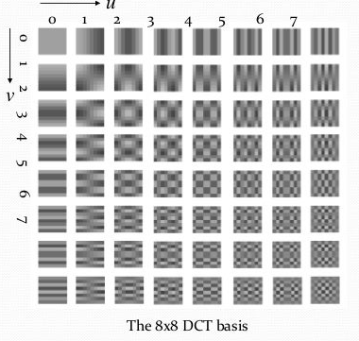
TRANSFORM CODING
Transform coding = describe the file a different way before shrinking it
Instead of storing every pixel, it stores how much smooth colour and how much fine detail the image has
Almost everything your eye notices ends up in a few big numbers. The rest are tiny
Quantisation then rounds off the tiny numbers, or throws them away
So you lose fine detail, not whole chunks. A bad JPEG looks blurry, not full of holes
Used by JPEG (images) and MP3 (sound)

Slide 24
TRANSFORM CODING: YOUR NOTES
-> Notes Q6 [2 marks] - do it now
Q6 Outline what transform coding does to a file before any data is discarded. [2]
Two marks, so two things: the change of representation, and why that change makes discarding safe.

Slide 25
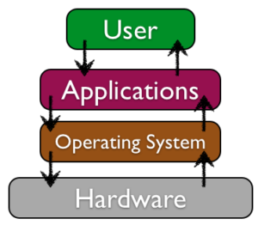
CLOUD COMPUTING
A NAS is storage you own, that you are responsible for
The cloud is just that but it’s somebody else's hardware that you’re renting
There are three service models, each taking control of some of these layers

Slide 26

SAAS
SaaS - Software as a Service
You are given a functioning application that another organization controls the backend of
Examples: Google Docs, ManageBac, Gmail, Netflix
Least control and least work. You cannot change the software or the machine it runs on.
You do not choose the operating system or hardware

Slide 27

PAAS
PaaS - Platform as a Service
You rent a virtual computer to deploy your own code, with the OS, runtime and scaling handled for you
Examples: Google App Engine, Heroku, Microsoft Azure App Service
You control the application. You do not control the machine
This is what your IA would likely use if you ever put it online.

Slide 28
IAAS
IaaS - Infrastructure as a Service
You are handed a virtual machine, storage and a network, and nothing else
Examples: Amazon EC2, Google Compute Engine, Azure Virtual Machines
Most control and most work: you pick the OS, install the software, and patch it when it breaks
Also the model that scales furthest, because nothing about the setup is fixed for you.

Slide 29
HOW MUCH OF IT IS YOURS?
IaaS
You manage: operating system, runtime, application, data
PaaS
You manage: application, data
SaaS
You manage: your data (maybe if their privacy policy is good)
Control and convenience – the tradeoff. Every organization decides what they need and go from there. Alcuin uses almost entirely SaaS.
-> Notes Q7 [3 marks] - fill in the cloud table now

Slide 30
LAB
-> Notes Q8, Q9 and Q10 [8 marks]
Q8 Describe two differences between an SSD and an HDD. [2]
Q9 A company must choose its own operating system, install its own database software, and patch both itself. Explain why IaaS suits this company better than SaaS. [3]
Q10 A streaming service compresses its audio using a lossy method. Explain why this is acceptable for the audio but would not be acceptable for the company's payroll spreadsheet. [3]

Slide 31
LAB ANSWERS
Q8 No moving parts against spinning platters and a moving head; the SSD is far faster; the HDD is cheaper per gigabyte
Q9 IaaS hands over the virtual machine, so the OS, the installed software and the patching all belong to the customer. SaaS is only the finished application
Q10 Lossy throws away detail listeners will not notice and the size saving matters for streaming. Payroll figures have no unnoticeable detail - one altered digit is permanently wrong data

Slide 32
PA A1-2: COMPRESSION
You have just encoded three strings by hand. Let’s write a program to do it for us.
This should be like PA A1-1: read a file, process it, report the numbers, then explain the behaviour you observed.

Slide 33
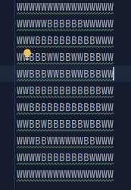
THE INPUT FILE
Download from the Resources tab: A1-Bitmap.txt
11 rows, 16 characters each. W is a white pixel, B is a black pixel. 176 characters in total
If you print it out you might see a picture!
Ensure you’re being careful of the newline characters

Slide 34
THE FOUR PARTS
Part 1 [4] load_image() - the file into a list of rows
Part 2 [8] rle_encode() - one row in, a '16W' string out
Part 3 [6] compression_report() - totals and ratio
Part 4 [2] rle_decode() - prove the round trip is lossless
Reflection R1-R4 [10] Five Laws of Codecraft [5]
Target numbers: 176 characters in, 91 out, 1.93 : 1, 48.30% saved.

Slide 35
WORK TIME
Ten minutes. Parts 1 and 2 are today's goal.
rle_encode() is the whole assignment. Get it right on one row before you loop over eleven
Finished early? Part 4, then the reflection questions
Whatever is left goes home. Due at the start of Lesson A1-5.

Slide 36
IN CLOSING
Your bitmap will go from 176 characters to 91 and lose no information.
A JPEG of John Compression will never be the same again ☹
Both of those are decisions about how to write bits down.
Next time: A1-5 - Data Representation. Binary, hexadecimal, and what those bits were saying all along.

Slide 37

VOCABULARY TO REMEMBER
Secondary storage
Non-volatile
HDD
SSD
eMMC
NAS
Optical drive
Flash drive
Memory card
Compression
Lossless compression
Lossy compression
Run-length encoding
Compression ratio
Transform coding
Quantisation
SaaS / PaaS / IaaS

